Slide 1
CS213 – 2022 / 2023
Programming II
Lecture 5: OOP – IV
Virtual and Friend Functions
Cairo University, Faculty of Computers and AI
By
Dr. Mohammad El-Ramly

Slide 2
There is no substitute for hard work !
(Thomas Edison)
لا بديل عن العمل الجاد
((توماس أديسون
6-<number>

Slide 3

Who said …...

Slide 4

Who said …...

Slide 5
I have nothing to offer but blood, toil, tears and sweat.
......
You ask, what is our aim? I can answer in one word: Victory. Victory at all costs.
) Winston Churchill)
لا شئ لدى أقدمه لكم سوى الدم و العرق و الدموع ، ..... ، و تسألنى عن هدفنا؟ أجيب بكلمة واحدة: النصر ، النصر مهما كانت التكلفة.
((وينستون تشرشل
6-<number>

Slide 6
Lecture Objectives
Reviewing Inheritance
Virtual functions and their use
Friend functions and their use
Very Good C++ Series
https://www.youtube.com/watch?v=oIV2KchSyGQ&list=PLlrATfBNZ98dudnM48yfGUldqGD0S4FFb
6-<number>

Slide 7
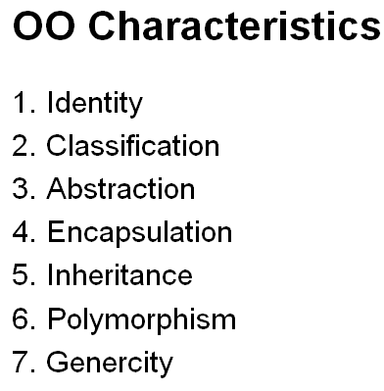
C++ Object System
Object-oriented features
  Classes
  Objects, with dynamic lookup of virtual functions (Polymorphism)
  Inheritance (Subtyping)
    Single and multiple inheritance
    Public and private base classes
  Encapsulation
    Public, private, protected visibility
    Hiding internal details while fixing the external interface

Slide 8
OOP in 7 Min
https://www.youtube.com/watch?v=pTB0EiLXUC8

Slide 9
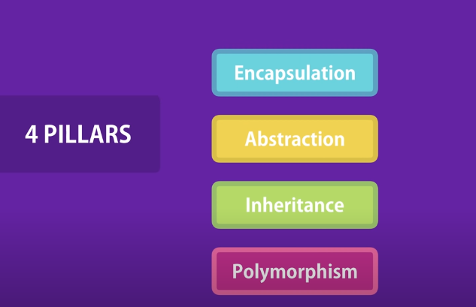

Slide 10
Important Terminology
Inheritance
Polymorphism
Overloading
Overriding
Virtual functions
Static binding
Dynamic binding

Slide 11
1. More on Inheritance?
Another mechanism for code reuse.
A process of deriving classes from a base class without disturbing the implementation of the base class.
Inheritance models the Is-A relationship. In a Is-a relationship the derived class is a variation of the base class.
Ex: Vehicle is a class
  Car is a Vehicle => Car derived from Vehicle

Slide 12
Inheritance
Derived class inherits all member functions from the base class. It may accept, disallow, or redefine them.
Derived class can define new functions.
Derived class can access public and protected members of the base class.

Slide 13
Constructor and Base class initialization
Constructors should be defined for each derived class.
If there is no constructor in a derived class, a default zero-parameter constructor will be generated which in turn calls the zero-parameter constructor in the base class to initialize the inherited members
  Derived() : Base() { }

Slide 14
Overriding a method
(member function)
Overriding base class methods: Derived class methods must have the same signature and compatible return types with the base class methods.
Partial overriding: overriding base class methods by adding more functionality.

Slide 15
Example of partial method overriding
class AnotherWorker : public Worker
{
public:
void doWork(){ // overriding base method
Worker::doWork(); // call base method
drinkCoffee(); // new method
Worker::doWork(); // call base method
}
};

Slide 17
What a derived class inherits
Every data member defined in the parent class (although such members may not always be accessible in the derived class!)
Every ordinary member function of the parent class (although such members may not always be accessible in the derived class!)
The same initial data layout as the base class

Slide 18
What a derived class doesn't inherit
The base class's constructors and destructor
The base class's assignment operator
The base class's friends

Slide 19
What happens when a derived-class object is created and destroyed
Space is allocated (on the stack or the heap) for the full object (that is, enough space to store the data members inherited from the base class plus the data members defined in the derived class itself)
The base class's constructor is called to initialize the data members inherited from the base class
The derived class's constructor is then called to initialize the data members added in the derived class
The derived-class object is then usable
When the object is destroyed (goes out of scope or is deleted) the derived class's destructor is called on the object first
Then the base class's destructor is called on the object
Finally the allocated space for the full object is reclaimed
http://burks.bton.ac.uk/burks/language/cpp/cppfaq/privatei.htm

Slide 20
Three Types of Inheritance
“public” inheritance
Base Derived
private (invisible)
protected protected
public public
“private” inheritance
  Base Derived
  private (invisible)
  protected private
  public private
“protected” inheritance
  Base Derived
  private (invisible)
  protected protected
  public protected
protected, public parts will be
unchanged
(struct’s default)
protected, public parts will be
private
(class’s default)
protected, public parts will be
protected

Slide 22
2. C++ Virtual Function
C++ virtual function is a member function of a class, whose functionality can be over-ridden in its derived classes.
The whole function body can be replaced with a new set of implementation in the derived class.

Slide 23
Properties of Virtual Functions
The main difference between a non-virtual C++ member function and a virtual member function is in the way they are both resolved.
A non-virtual C++ member function is resolved during compile time or static binding. Virtual Functions are resolved during run-time or dynamic binding
Virtual functions are member functions of a class declared with the keyword virtual.
Virtual function takes a different functionality in the derived class.

Slide 24
Example Virtual Functions
Compiler generates the code that will select the appropriate function at runtime
Example:
  class Employee {
  public:
  virtual void CalcPay ();
  };
  class SalariedEmployee :public Employee{
  public:
  virtual void CalcPay ();
  };
virtual specifier needs to appear in base class only.

Slide 25
Example Virtual Functions
Employee *p0 = new Employee;
Employee *p1 = new SalariedEmployee;
p0->CalcPay(); // calls Employee::CalcPay()
p1->CalcPay(); // calls SalariedEmployee::CalcPay()

Slide 26
Another Example
class Parent {
public:
nonVirtualFunction () {
cout << "\nParent Non Virtual ";
}
virtual virtualFunction () {
cout << "\nParent Virtual ";
}
};
class Child: public Parent {
public:
nonVirtualFunction () {
cout << "\nChildNon Virtual";
}
virtual virtualFunction () {
cout << "\nChild Virtual";
}
};

Slide 27
Why Virtual Functions?
Virtual functions support polymorphism.
A virtual operation can have different implementations in children classes.
A pointer of type parent can point to any child.
At run time, the exact method is called based on the current object.
•
•
•
•
area
Shape* shapes [4]
area
area
area

Slide 29
vtable
Whenever a program has a virtual function declared, a vtable is constructed for the class.
The vtable consists of addresses to the virtual functions for classes that contain one or more virtual functions.

Slide 30
Sample Class 1-Dimension Point
  class Point {
  public:
  Point(int xv);
  Point(Point* pv);
  int getX();
  virtual void move(int dx);
  protected:
  void setX(int xv);
  private:
  int x;
  };
Overloaded constructor
Public read access to private data
Virtual function
Protected write access
Private member data

Slide 31
Sample Derived Class Colored Point
Public base class gives supertype
  class ColorPt: public Point{
  public:
  ColorPt(int xv,int cv);
  ColorPt(Pt* pv,int cv);
  ColorPt(ColorPt* cp);
  int getColor();
  virtual void move(int dx);
  virtual void darken(int tint);
  protected:
  void setColor(int cv);
  private:
  int color;
  };
Overloaded constructor
Non-virtual function
Virtual functions
Protected write access
Private member data

Slide 32
Run-time representation
Point object
Point vtable
Code for move
vptr
x
3
ColorPoint object
ColorPoint vtable
Code for move
vptr
x
5
color
blue
Code for darken
Data at same offset
Function pointers at same offset

Slide 33
Virtual functions
Member functions are either
  Virtual, if explicitly declared or inherited as virtual
  Non-virtual otherwise
Virtual functions
  Accessed by indirection through pointer in object
  May be redefined in derived (sub) classes
Non-virtual functions
  Are called in the usual way. Just ordinary functions.
  Cannot be called through pointer to base type
Pay overhead only if you use virtual functions

Slide 35
General rules
Non-virtual functions: static binding is resolved at compile time.
Virtual functions: dynamic binding is resolved at run-time

Slide 36
Abstract Methods
An abstract method or pure virtual function, has no meaningful definition in the base class and must always be defined in derived classes.
An abstract class contains at least one abstract method and can NOT be instantiated and must be inherited to be useful.
  Example: shape class

Slide 37
The Abstract Base Class Shape
class Shape {
public:
Shape(string& shapeName = "" ) {name = shapeName;}
virtual ~Shape( ) { }
virtual double area( ) = 0; //abstract method
bool operator< (Shape & rhs ) const
{ return area( ) < rhs.area( ); }
virtual void print()
{ cout << name << " of area "<< area( ); }
private:
string name;
};

Slide 38
Examples: Expanding the Shape class
Provide new constructors
Write definition for inherited pure virtual functions.
Example:
Shape *a, *b;
a = new Circle (3, 0) //legal
b = new Shape ("circle") //illegal

Slide 40
3. It’s good to have friends
A friend function of a class is defined outside the class’s scope (I.e. not member functions), yet has the right to access the non-public members of the class.
Single functions or entire classes may be declared as friends of a class.
These are commonly used in operator overloading. Perhaps the most common use of friend functions is overloading << and >> for I/O.

Slide 41
Friends
Basically, when you declare something as a friend, you give it access to your private data members.
This is useful for a lot of things – for very interrelated classes, it more efficient (faster) than using tons of get/set member function calls.
This allows more freedom is design options.

Slide 42
Friends
A class doesn't control the scope of friend functions so friend function declarations are usually written at the beginning of a .h file.
Public and private don't apply to them.

Slide 43
Friends (a few details)
Friendship is not inherited or transitive.
  Derived classes don’t receive the friendship of base class
  The privileges of friendship aren’t transitive. If class A declares class B as a friend, and class B declares class C as a friend, class C doesn’t necessarily have any special access rights to class A.
  If class A declares class B as a friend (so class B can see class A’s private members), class A is not automatically a friend of class B (so class A cannot necessarily see the private data members of class B).

Slide 44
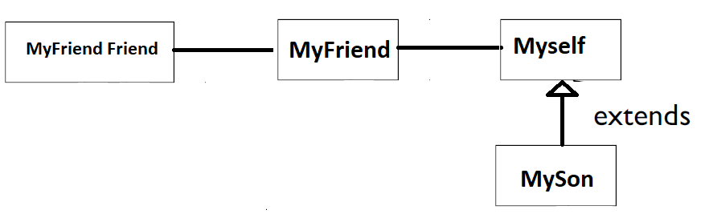
Friends (a few details)
MyFriend Friend is not my friend
MySelf is not his friend
MyFriend is not his friend

Slide 45
Friends Example
class SomeClass {
  friend void setX(SomeClass&, int);
  int someNumber;
  ………… rest of class definition
  }
  // a function called setX defined in a program
  void setX( SomeClass &c, int val) {
  c.someNumber = val;
  }
  // inside a main function
  SomeClass myClass;
  setX (myClass, 5); //this will work, since we // declared setX as a friend

